Slide 1
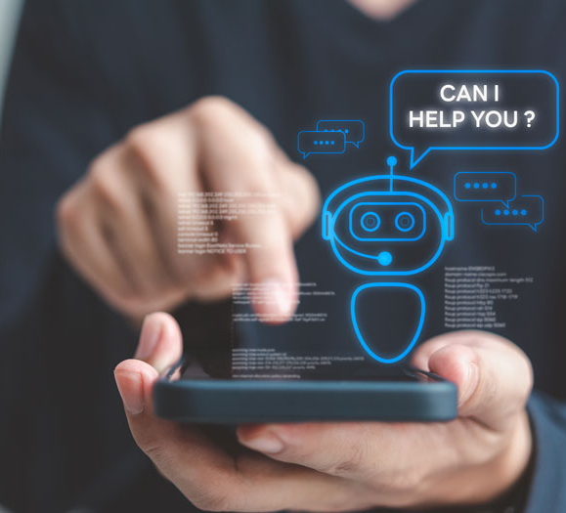
SeeSense AI: Visual Assistant for the Visually Impaired
SUBMITTED BY:
Harsh raj
Harveen Kaur
Priya
Vishesh kumar

Slide 2
Introduction
What is SeeSense AI?
SeeSense AI is an intelligent visual assistant designed specifically for the visually impaired. It utilizes real-time object and obstacle detection using cutting-edge AI to help users navigate their environment independently and safely. By integrating AI and audio feedback, it provides timely alerts to users about potential hazards, helping them make informed decisions while moving around

Slide 3
Project Overview
Goal: To assist visually impaired individuals in navigating complex environments through real-time object recognition and obstacle detection, enhancing their independence and safety.
Features:
- Real-Time Object Recognition: Identifies everyday objects like furniture, doors, and walls.
- Obstacle Detection: Detects barriers or obstacles such as walls or furniture that might pose a risk to the user.
- Audio Feedback: Provides spoken alerts or guidance to inform the user of their surroundings.
- Interactive Interface: An easy-to-use interface with minimal setup, enabling seamless real-time interaction.

Slide 4
Core Technologies
1. Google Gemini AI: Used for object and obstacle detection. Provides real-time predictions with high accuracy.
2. Streamlit: A web app framework for creating an interactive, easy-to-use frontend interface.
3. OpenCV: Used for real-time video capture and processing.
4. Pyttsx3: A text-to-speech library used to provide real-time audio feedback.
5. Requests: Handles communication with the Gemini API to retrieve AI predictions based on real-time camera input.

Slide 5
How it works
Step-by-Step Process:
1. Video Capture: The user starts the camera feed by clicking on the 'Start Camera' checkbox.
2. AI Processing: Each captured frame is sent to Google's Gemini AI API to analyze and identify objects.
3. Prediction Analysis: The AI provides predictions, which include object types and their confidence levels.
4. Obstacle Detection: If an obstacle like a wall or barrier is detected, an alert is triggered to notify the user.
5. Audio Feedback: The app uses Pyttsx3 to trigger audible alerts like 'Obstacle detected! Please proceed with caution.'

Slide 6
Key Features
1. Real-Time Object Recognition: Detects and labels objects like doors, walls, and furniture in real-time.
2. Obstacle Detection: Identifies obstacles such as walls and barriers to help users navigate safely.
3. Audio Feedback: Provides timely audio alerts to inform the user of obstacles or objects detected.
4. Interactive UI: Powered by Streamlit for an easy-to-use and intuitive interface.

Slide 7
Live Demonstration
How It Works in Action:
1. Starting the Camera: Users click the 'Start Camera' checkbox to initiate real-time video capture.
2. Object Detection in Real-Time: The app uses Gemini AI to process and identify objects in the environment.
3. Obstacle Alerts: If the AI detects an obstacle, the app provides an audio alert.
4. Visual Feedback: The app highlights detected obstacles and objects on the video feed.

Slide 8
Challenges Faced
1. Real-Time Video Processing: Ensuring smooth video processing without lag.
2. API Limitations: Accuracy of predictions was sometimes affected by lighting or environmental conditions.
3. Audio Feedback Integration: Balancing clear audio feedback with other activities within the app.
4. Device Compatibility: Ensuring the app works across various devices and camera capabilities.

Slide 9
Future Enhancements
.
2. Enhanced Object Classification: Expanding the object detection to include more categories like furniture or pets.
3. Integration of Additional Sensors: Using sensors like ultrasonic, infrared, or LiDAR for better obstacle detection.
4. Contextual Navigation Assistance: Providing navigation guidance, such as 'Turn left after 10 feet.'
5. Improved Voice Commands: Integrating voice recognition for hands-free interaction with the app.

Slide 10
Conclusion
Impact on Accessibility: SeeSense AI has the potential to significantly improve the lives of visually impaired individuals by providing real-time, AI-powered assistance.
Future Vision: The app aims to evolve into a comprehensive navigation tool with advanced features and contextual assistance.
Call to Action: By continuously improving the app through feedback and new technologies, SeeSense AI can become a critical tool for enhancing independence and safety for visually impaired users.

